Slide 1

Childhood Health
& Wellness

Slide 2
Childhood Health
& Wellness
Projects

Slide 3
Healthy
Lifestyles

Slide 4
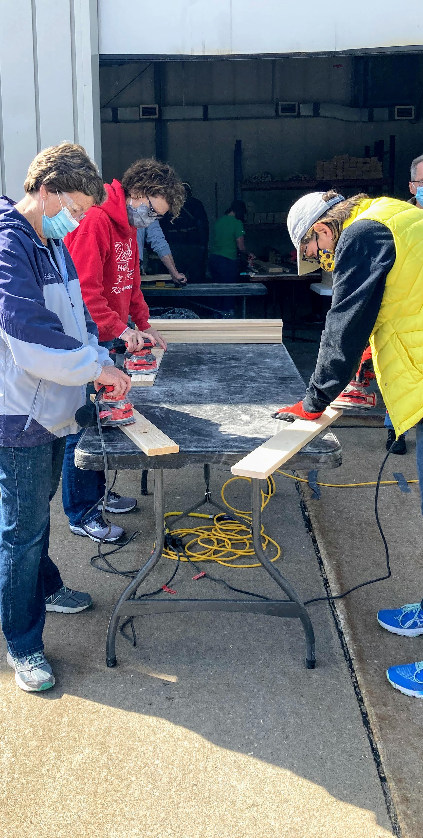
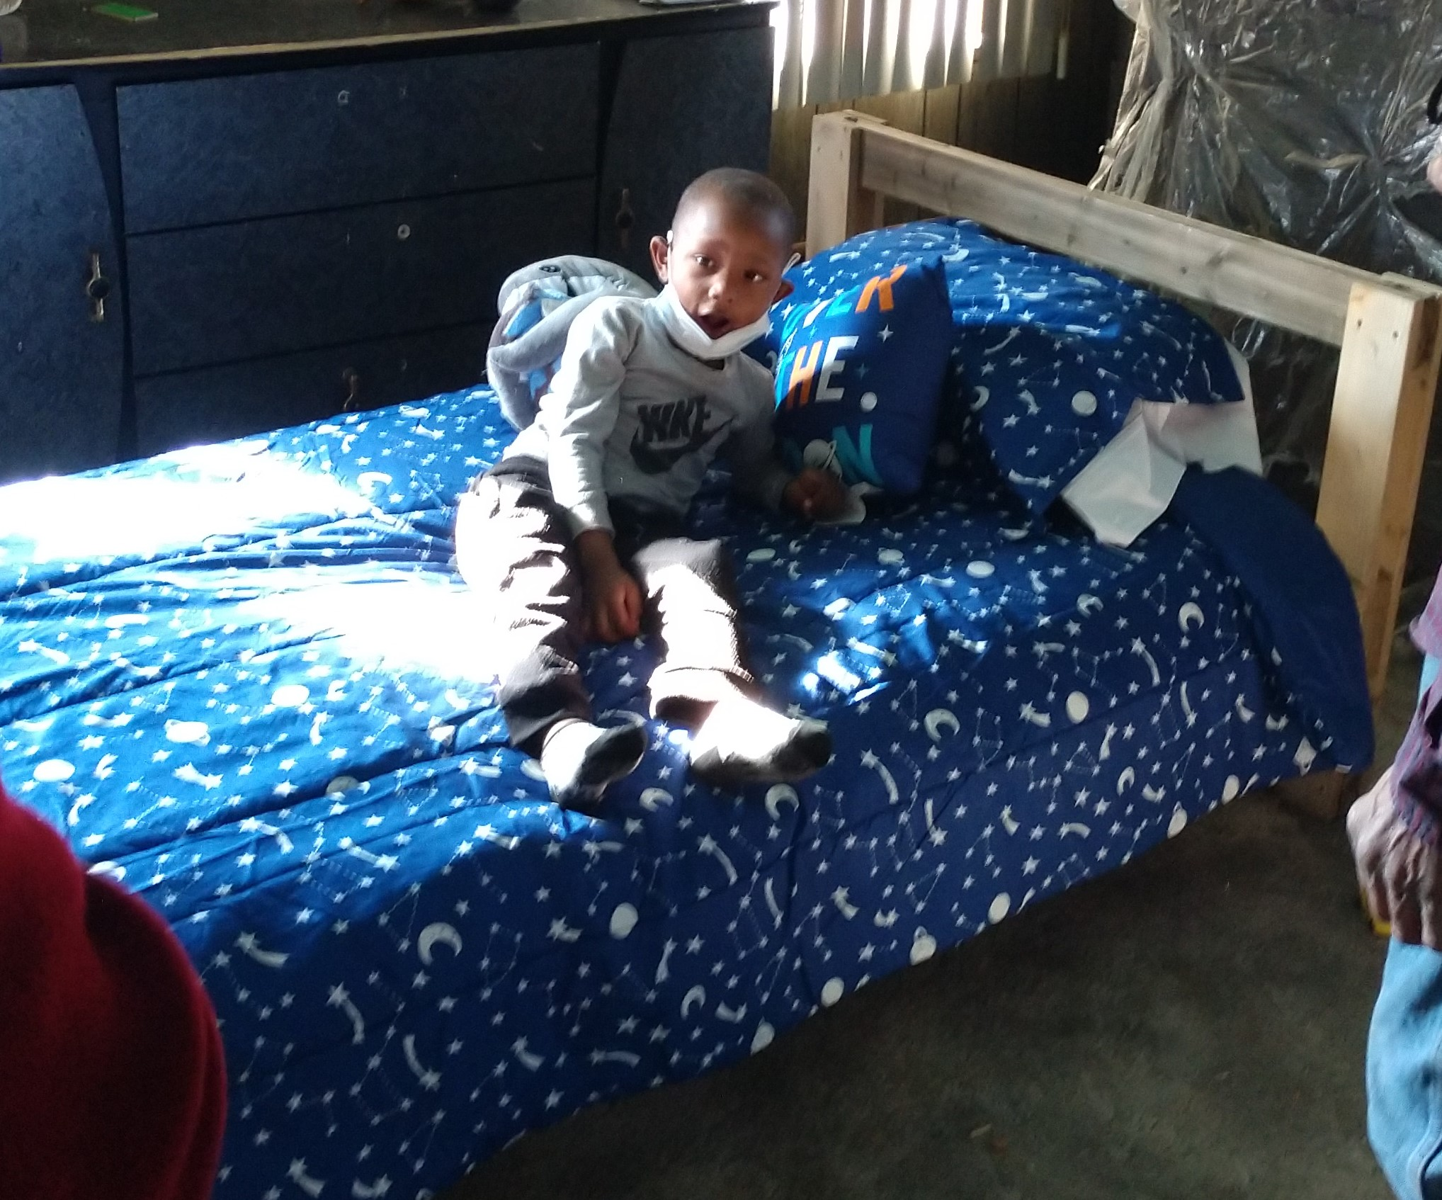
Sleep in Heavenly Peace
Beds for Children
Optimist Club of Flint, MI-West
Optimist Club of Maquoketa, IA
Higher Works Collaborative
Physical Activity-Food Choices-
Dental Health
St. Cloud Morning Optimists, St. Cloud, MN

Slide 5
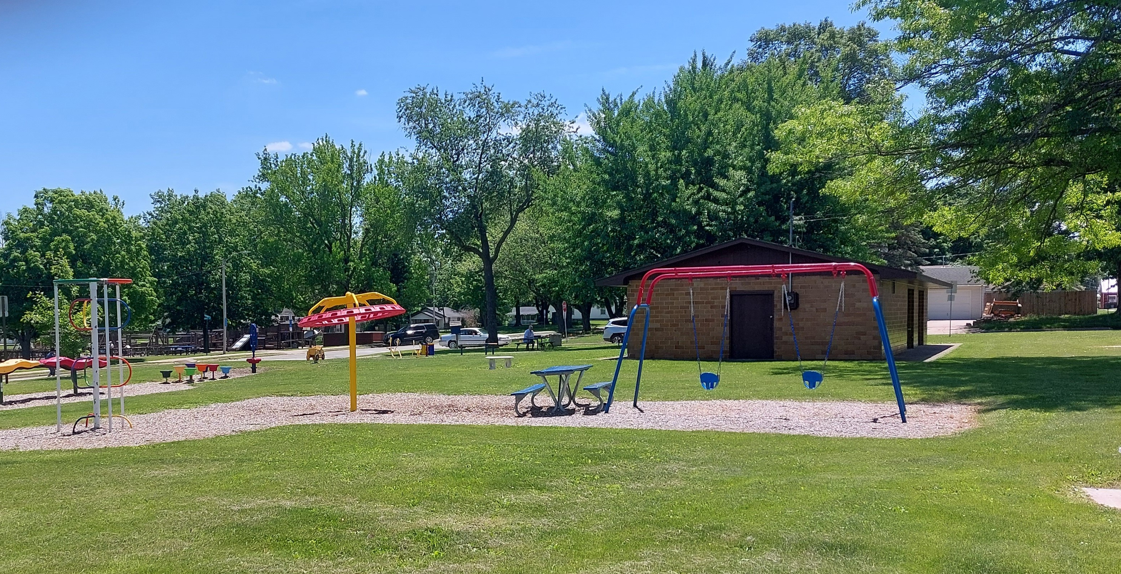
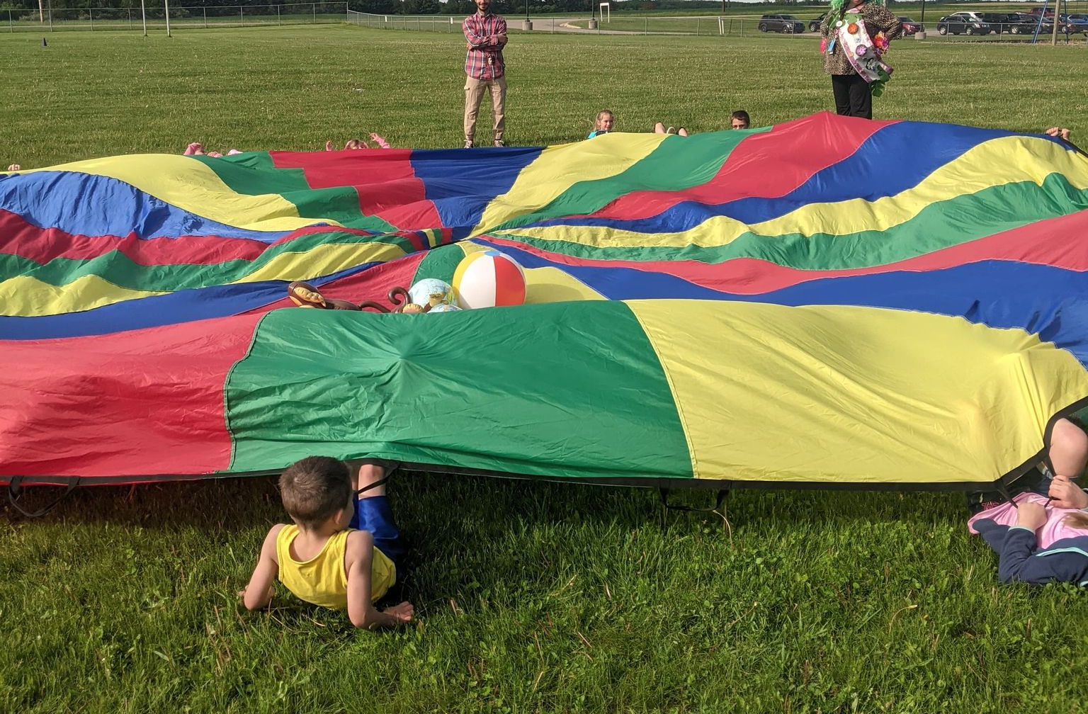
Optimist Children Playground
Outdoor Activity
Optimist Club of Knoxville, IA
School Elementary Field Day
Physical Fitness,
Healthy Eating
Cardinal Optimist Club of Skidway Lake, MI

Slide 6
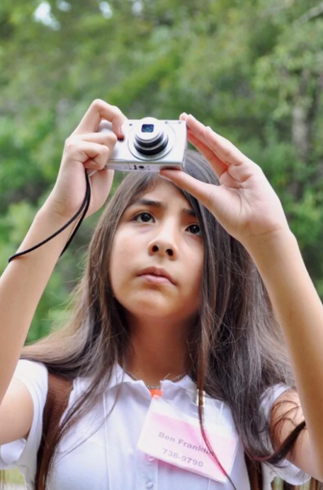
Picture Your World
Being healthy can be fun
You can learn new skills while being healthy
Partnership with Green Spaces Alliance-Picture Your World

Slide 7
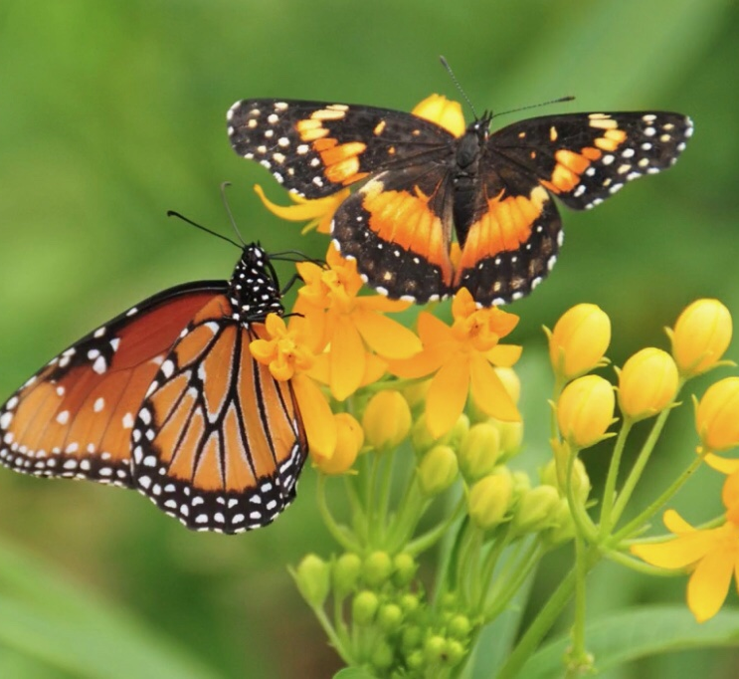
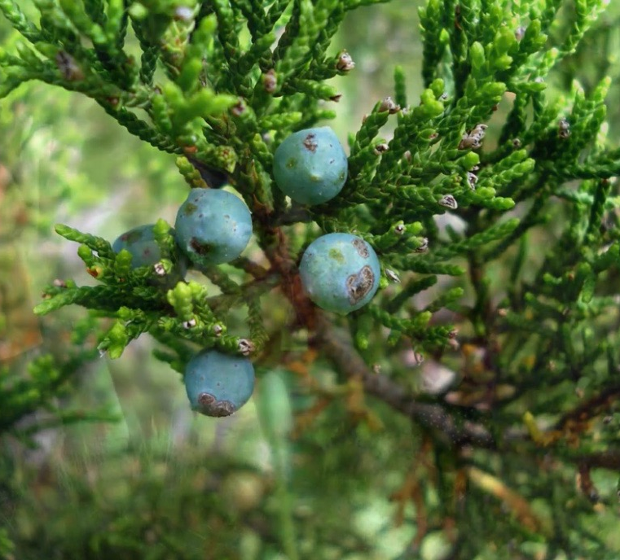

Introductory Photography lesson
Hike and photography through natural area

Slide 8
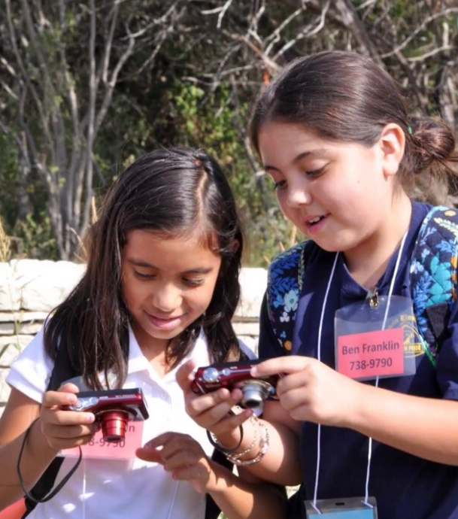
Participants learn about photography and nature while getting healthy through hiking
After the hike they enjoy lunch together
Their pictures are reviewed and edited
The youth's favorites are published into a book

Slide 9
Chronic
Diseases

Slide 10
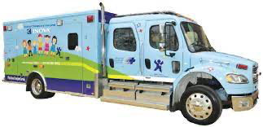
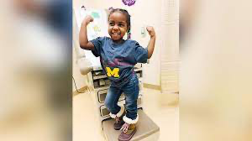
Pediatric Ambulance Transport
Supporting Hospital Transport for children
Optimist Club of Twin Falls Inc., ID
Sickle Cell Disease
Educate school personnel about the
Medical condition
Tuskegee Optimist Club, AL

Slide 11
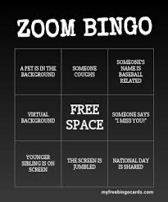
Optimist Family Game Nights
Live Bingo by Zoom, interspersed with song
and personal interviews
Childhood Cancer Optimist Club, SC
LOL Night at the Races
Food Sponsor for Childhood Cancer Families
Highland Optimist Club, IL

Slide 12

Ronald McDonald House and Blank Children's
Hospital Support
Making Fleece Blankets for young patients
and providing sibling support
Optimist Club of Des Moines-Western Noon, IA

Slide 13
Mental
Wellness

Slide 14
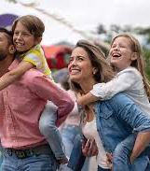
JAM (Just a Minute) in the Park Family Event targeting coping and stress reduction
Optimist Club of Temple, GA
Mental Health Awareness Day
Strategies for Depression, Anxiety, Grief
West Jay Optimist Club, IN

Slide 15
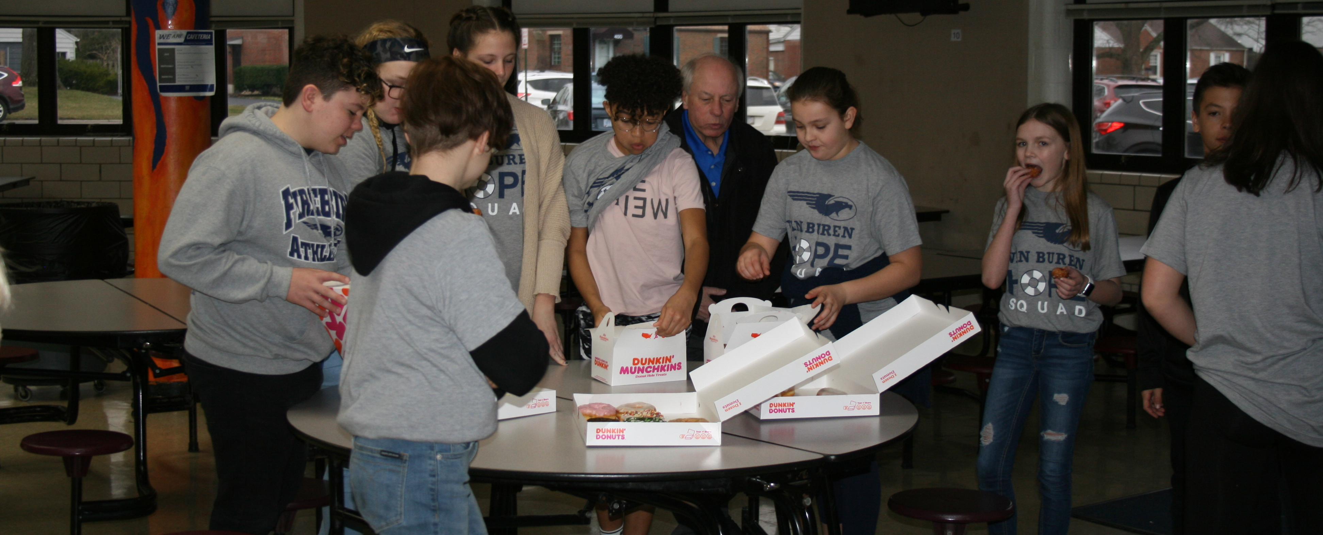
HOPE Squads
Peer to Peer suicide prevention, self-care &
anti-bullying in Middle and High Schools
Dor-Wood Optimist Club of Kettering, OH
Little Engine Family Engagement
Early Childhood Activities:
Developmental-Learning- “Do-It”
Boone, IA Optimist Club

Slide 16

Teen Mental Wellness Community Forum
Southfield-
Lathrup Village
Optimist Club, MI

Slide 17
Disabilities

Slide 18
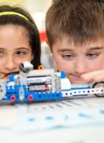
Summer Inclusion Camp
Special Needs camp to try new things
Optimist Club of Westfield, NJ
Toys and Tools to Thrive
Items needed for exceptional youth
Bellbrook Sugarcreek Optimists, OH

Slide 19
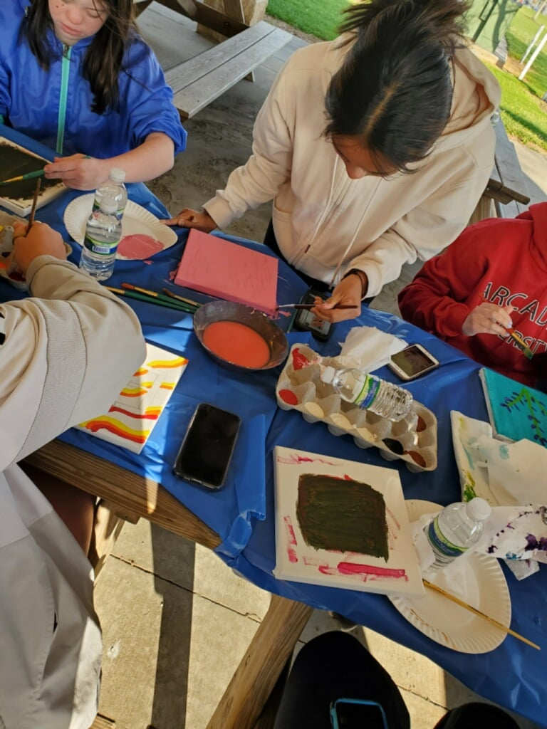
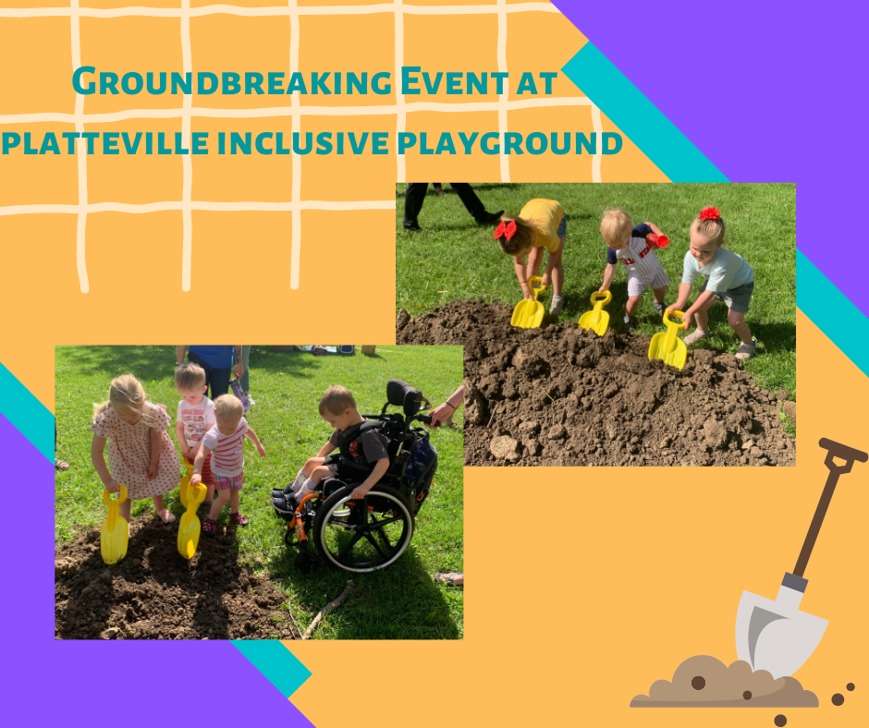
Daniel Boone Connections Program
High school students and exceptional youth;
As peers connect, form lifelong friendships
Daniel Boone Optimist Club, Douglassville, PA
Platteville Inclusive Playground
Outdoor Accessible facility for
exceptionalities
Optimist Club of Platteville, WI

Slide 20
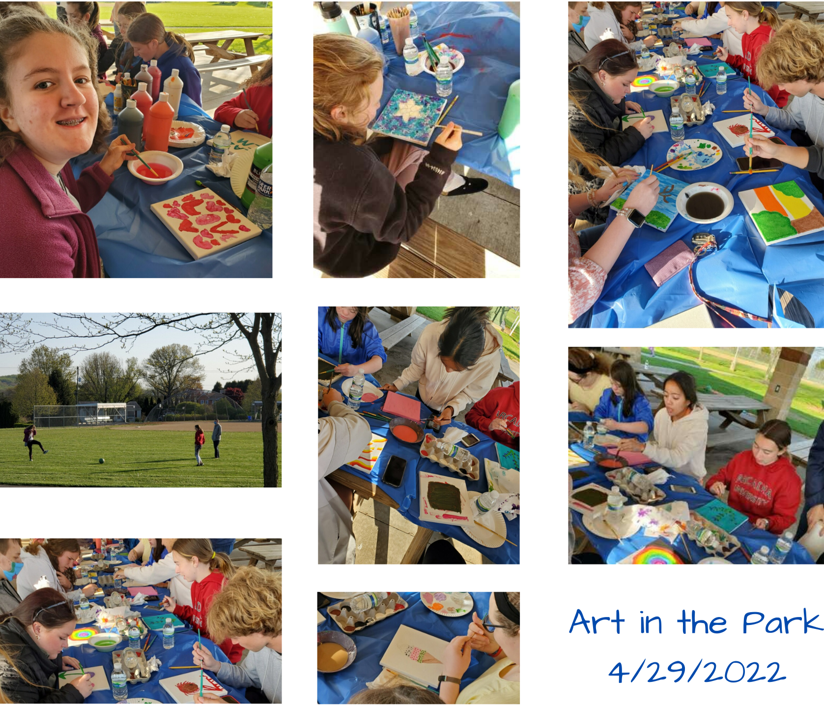

Slide 21
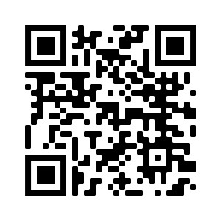
Community
Programs & Projects
programs@optimist.org

