Slide 1

Optimist Clubs
“Bringing Out the Best in Kids”

Slide 2
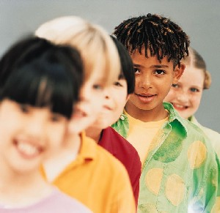
Optimist Clubs…
Have been "Bringing Out the Best in Kids" since 1919.
Conduct positive service projects aimed at providing a helping hand to youth.

Slide 3
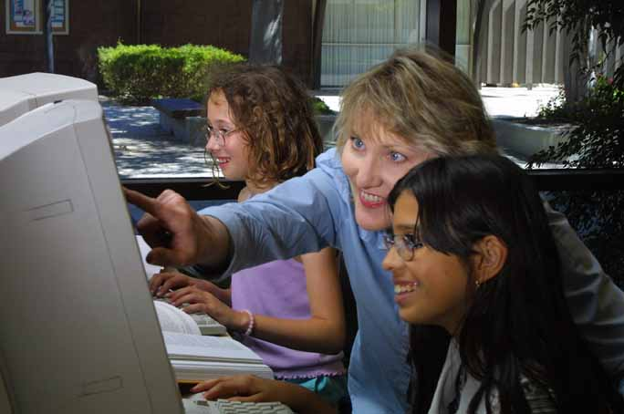
Club members are best known in their communities for their upbeat attitudes.

Slide 4
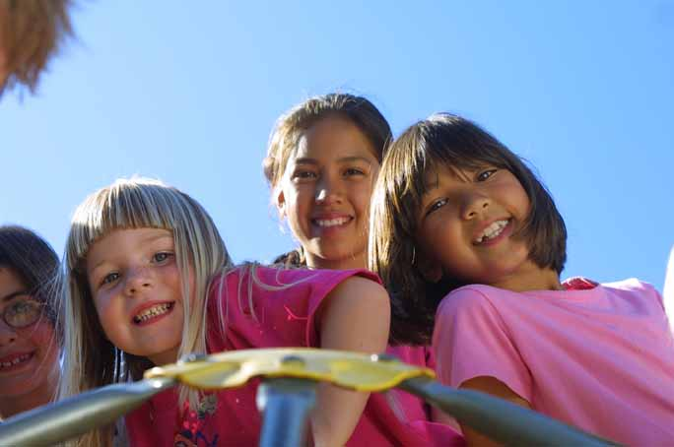
By believing in young people and empowering them to be the best they can, Optimist volunteers continually make this world a better place to live.

Slide 5
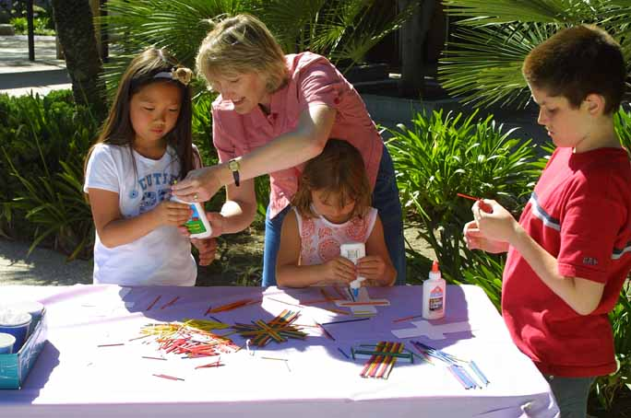
Optimists conduct 65,000 service projects each year, serving six million young people.

Slide 6




Youth Clubs
Scholarships
Optimist International Junior Golf Championships

Slide 7

Youth Appreciation Week
Tri-Star Sports Skills
…and many more created by local Clubs to meet the needs of their communities!

Slide 8
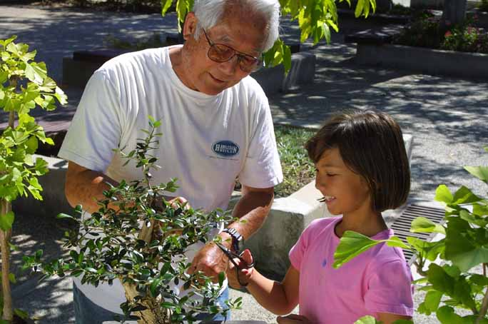
Optimists value
  Learning
  Leadership
  Excellence
  and a sense of community

Slide 9
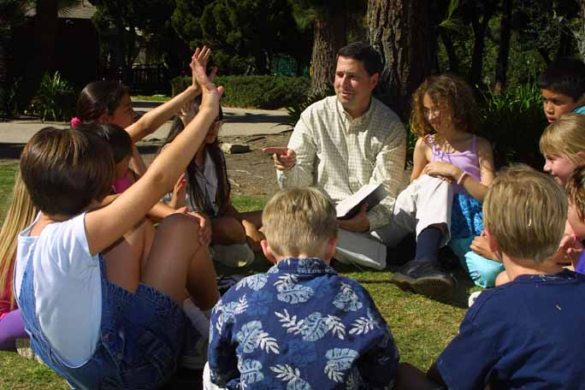
Being an Optimist is something that anyone can do.
“You can dream, create the most beautiful place in the universe...but it takes people to make that dream a reality.” ---Walt Disney

Slide 10


Slide 11

For more information on being a part of a local Optimist Club, contact….
at 1-800-500-8130 or at membership@optimist.org
Or contact an Optimist Club member in your area

