Slide 1
Club and District Recognition Program
&
2017-2018
Incentives
Optimist International

Slide 2
CLUB RECOGNITION
"Bringing Out the Best" Club
    (Banner Patch then year bar thereafter)
  Complete at least two service projects a year (submit President’s Pride Report)
  Add at least two members
  Be current on District and OI dues
  Recognize a Club member or local community individual
  Conduct a Membership Recruitment Drive (ie NOW Program)

Slide 3
CLUB RECOGNITION
Honor Club
  (Banner Patch, year bar with Club President’s name; thereafter a year bar with Club President’s name)
  Complete all "Bringing Out the Best" Club requirements PLUS
  Complete at least one more service project a year
  Submit Club Officer Elect Report
  Grow Club by net plus 3
  Appoint a Club Foundation Rep and make a non restricted contribution to the OIF/CCOF
  Club President, Club President Elect (or 2 designees) attend District Convention (or 2 other District meetings/conferences)

Slide 4
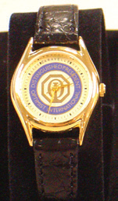

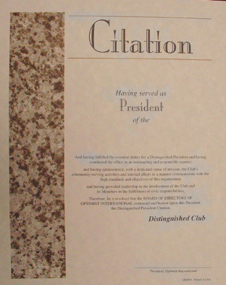
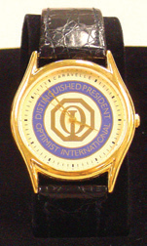
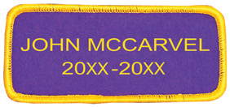
CLUB RECOGNITION
Distinguished Club
  (Watch for Club President and Secretary and/or Treasurer and a banner patch with the Club President’s name; thereafter a year bar with Club President’s name and watch)
  Meet Honor Club Criteria plus one of the following;
    Add net +15 in membership or
    Build one or more new clubs or
    Increase membership by +8 AND build 2 or more JOI Clubs

Slide 5
DISTRICT RECOGNITION
Distinguished Lieutenant Governor:
(desk clock)
  All Clubs in the Zone are Honor Clubs OR
  Net +6 in membership and charter one of more Clubs (JOOI excluded) AND
  All Clubs current on District and OI Dues (all financial obligations paid by September 30) AND
  All reports filed with Optimist International on a timely basis AND
  50% of Clubs appoint a CFR and make a donation to OIF/CCOF AND
  Attend 75% of all District meetings/conferences AND
  Attend all Club meetings once or ore, including any new Clubs built
Notes:
To achieve Honor Club status a club must:
To achieve Honor Club a Club must:
• Complete three service project a year and submit the President’s Pride Report.
• Recognize a Club member or local community individual
Grow the Club by net plus 1
Be current on District and Optimist International dues

Slide 6
DISTRICT RECOGNITION
Honor Governor:
(Lapel pin for Governor and District Secretary/Treasurer and District banner patch)
Grow District by net plus 10 in membership
All reports filed with Optimist International on a timely basis
all clubs current on District and OI Dues (all financial obligations paid by September 30)
50% of Clubs appoint a CFR
$7500 or more raised in Unrestricted Funds on behalf of the District
Charter one or more new adult Clubs

Slide 7
DISTRICT RECOGNITION
Distinguished Governor:
  (Governor’s Ring plus a District banner patch with the Governor’s name and year)
  Grow District by net plus +25 in membership
  All Clubs current on District and OI Dues (paid by September 30)
  District builds 3 or more adult Clubs
  All reports filed with Optimist International in a timely manner
  50% of Club appoint a CFR and make an unrestricted donation to the OIF/CCOF
  $7500 or more raised in Unrestricted funds on behalf of the District
Notes:
To achieve Honor Club status a club must:
To achieve Honor Club a Club must:
• Complete three service project a year and submit the President’s Pride Report.
• Recognize a Club member or local community individual
Grow the Club by net plus 1
Be current on District and Optimist International dues

Slide 8
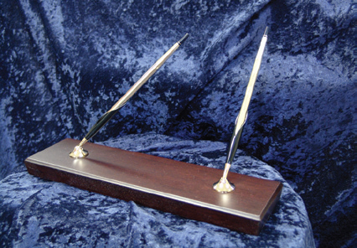
DISTRICT RECOGNITION
Distinguished District Secretary Treasurer:
  (“Bringing Out The Best In Kids” logo folder with ink pen)
  Be current on District and OI dues (paid by September 30 )
  All reports filed with Optimist International in a timely manner
  Grow District by net plus 25 in membership
  District to build at least 3 or more new adult Clubs
  50% of Club appoint a CFR and make an unrestricted donation to the OIF/CCOF
  $7500 or more raised in Unrestricted funds on behalf of the District
Governor Pacesetter Award:
  (Pen/pencil set given at Convention)
  Grow District by Net +15 in membership by June 30
  District to build at least two new clubs by June 30
Notes:
To achieve Honor Club status a club must:
To achieve Honor Club a Club must:
• Complete three service project a year and submit the President’s Pride Report.
• Recognize a Club member or local community individual
Grow the Club by net plus 1
Be current on District and Optimist International dues

Slide 9
CLUB & DISTRICT RECOGNITION
Please Note:
Recognition of the Administrative Year will not be announced until after January 10 of the following administrative year.
Submission of the Club Pride Report is required for proof of completed service projects.
All reports for Distinguished Governor are to be received for year the Governor served.

Slide 10
2017-2018 INTERNATIONAL INCENTIVES
ROOKIE ROCKSTAR AWARD
(Can be earned ONLY in the first twelve months of membership as recorded in the records of Optimist International)
  Serve on a Club Committee
  Work on a service project
  Sponsor a New Member
  Attend one of the following:
    District meeting
    Regional Summit
    OI Convention

Slide 11
2017-2018 INTERNATIONAL INCENTIVES
BUILDERS OF EXCELLENCE
Up to four Builders of Excellence can be named for each new adult Club, regardless of the number of sponsor Clubs
SPONSOR PIN INCENTIVE
Sponsor pins shall be awarded to members when sponsoring 1, 5, 15, 20 and 35 new members

