Slide 1
The Gift of Branding
Communications, Marketing & Technology Committee
Cheryl Brenn, Executive Director
cheryl.brenn@optimist.org

Slide 2
What we’ll cover:
Let’s learn the lingo…
What is “Branding”
Logo vs. Brand
Building Brand Identity
Your questions

Slide 3
Let’s learn the lingo…
Logo: a symbol or other design adopted by an organization to identify its products, uniform, vehicles, etc..
Icon: a symbol or graphic representation of a program, service or company
Trademark: a symbol, word, or words legally registered or established by use as representing a company or product.
Copyright: the exclusive legal right, given to an originator or an assignee to print, publish, perform, film, or record literary, artistic, or musical material, and to authorize others to do the same.
Marketing: the process by which companies / organizations create customer interest in products or services. It generates the strategy that underlies sales techniques, business communication, and business development. It is an integrated process through which companies build strong customer relationships and create value for their customers and for themselves.”
Public Relations: refers to managing how others see and feel about a person, brand, or company.
Brand Equity: the value that is derived from consumer perception of the brand name of a particular product or service, rather than from the product or service itself.

Slide 4
Let’s learn the lingo…
Branding is the perpetual process of identifying, creating, and managing the cumulative assets and actions that shape the perception of a brand in stakeholders’ minds.

Slide 5
Branding
Brand
Programs
Members
Identity
Community
Activities

Slide 6
Most Valuable Brands

Slide 7
What is our Brand?

Slide 8
What is our Brand?
Mission:
By providing hope and positive vision, Optimists bring out the best in youth, our communities, and ourselves.
Brand Promise: Optimists bring out the best in our youth, our communities, and ourselves

Slide 9
Our most visible brand asset

Slide 10
Brand Equity
The value that is derived from consumer perception of the brand name of a particular product or service, rather than from the product or service itself.

Slide 11
Brand Equity

Slide 12
Brand Equity

Slide 13
Our most visible brand asset = Brand Identity
LOGO
ICON
COLORS

Slide 14
Brand Assets

Slide 15
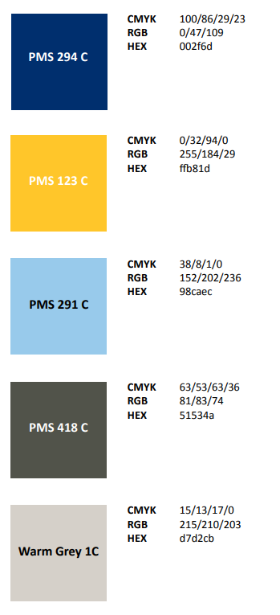
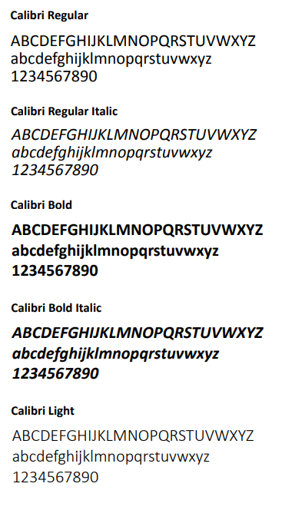
Brand Assets
Primary Color Pallet
Secondary Color Pallet
Primary Font Family

Slide 16
Brand Assets

Slide 17
Brand Identity
Optimist
Optimist
international
International
Optimist
Optimist
International
International
Optimist
Optimist
International
International

Slide 18
Brand Identity

Slide 19
Brand Identity Guidelines
Available: https://www.optimist.org/documents/OI_Brand_Guidelines.pdf

Slide 20
Questions

