Slide 1
2022-2023 District Leadership Development Chair Seminar June 30, 2022

Slide 2
Topics Include:
Introductions
Role of the District Leadership Development Chair
Providing Training of Value
Planning and Executing District Training
Facility Planning
Marketing District Training
Other District Seminars/Trainings
Targeting Your Audience
Developing Future Leaders
Action Plans
Notes:
Welcome and review agenda
Introduce ourselves (Trainers)
Participants Introduce:
Name
District
Experience in the job
Review Agenda
Questions are welcomed throughout the session

Slide 3
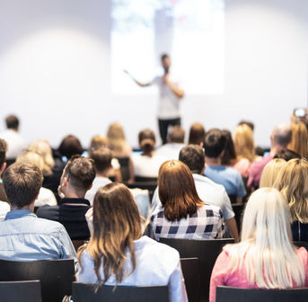
Role of the District LD Chair
What are the major functions of your role as Leadership Development Chair?
To plan and conduct training for officers and members
To promote the use of the Learning Management System (LMS), including training
To promote forthcoming training events
To cultivate and encourage future Optimist Leaders
Notes:
The Role of the District Leadership Chair - What are the major functions of your role? Are there others that are unique or specific to your District?
Discuss various roles, including:
Plan and promote training at:
District Convention
District Quarterly Conferences
Other training events
To Promote the LMS system and provide training for usage
To promote forthcoming training events utilizing:
District Bulletin
Email
District Website
Other methods
To consciously make an effort to identify and develop future leaders in your District, and work closely with the District Candidate Qualifications Committee to seek the best qualified candidates for District Chairs

Slide 4
Providing Training of Value
Work with the Governor & Convention Chair
Align LD Goals & Training with District Strategies & Plans
Promote Learning at All Levels
LMS
Develop Future Leaders
Collaborate with District Chairs
PDP
PGI
Communication
& Marketing
Planning
Notes:
A Premier Year of Training!
The goal: Effective planning for training that provides great value to Clubs/Officers/Optimist members
Essentials and foundational planning begin the process:
Work with the Governor and Convention Chair
Align LD goals and training with District strategies and plans
Collaborate with District Chairs
Promote learning at all levels
LMS
Develop future leaders
PGI/PDP
Plan, Plan, and Plan again!
Communicate, Communicate and Communicate again! Don’t forget marketing! Are these one in the same?
FOCUS - To achieve the Governor’s and District’s goals, don’t get side tracked!

Slide 5
Where Do You Begin?
Current Reality
District Meetings Now:
Attendance – Declined?
Complaints – Same Training?
Boring and Predictable?
Same Presentations?
Same Optimists Talking?
Your Future
District Meetings With:
Great Attendance
Relevant Training
Member Engagement
Motivation
Fun
Notes:
Where do you begin? How do you affect the change that will move your District from it’s current reality to the future?
Begin with the end in mind - Overarching goal is to provide excellent, relevant training to our District leaders and Optimists:
Facilitate - Group Input (Chart w/goal, if time allows) - What might be some strategies that you will employ to deliver excellent and relevant training throughout the year? (Answers: train officers, provide tools and resources to Clubs, website, webinars, conference calls/virtual, motivate and inspire Optimists...)
One example of how you might begin planning with your Governor and team:
Discuss where your District is now with regards to LD
Begin with Governor’s goals
Decide what your training goals are
Decide on overarching strategies you will use throughout your planning
Stay focused!

Slide 6
How will you deliver effective, relevant training?
Restructure District Meetings
Plan Timely, Informative, Relevant Training
Promote Upcoming Events
Bring FUN to Meetings!!!
Notes:
The overarching goal is to provide excellent, relevant training to our District leaders and Optimists. How will you do it?
Review examples listed on slide:
Restructure District Meetings to Engage Officers and Membership
Plan -- Timely, Informative, and Relevant Training
Promote Upcoming Meetings -- Early and Often
Bring Fun to Meetings -- Motivational Speakers, Raffles, Themes, Ice-Breakers…

Slide 7
Preparation and Resources
Establish your team – communicate and work together
Decide on trainings that will occur throughout the year
Follow Governor’s District goals/Collaborate with Chairs
Establish goals and themes for each event
Prepare your presenters
Resources on optimist.org and LMS
Certified International Trainers
Plan, plan, plan!
Communicate, communicate, communicate!
Notes:
Now let’s talk more about you and your job as an LD Chair. Your preparation and resources will lead you to success.
Go through each step listed on the slide.
Follow these reminders for success:
Work with your governor
Support their goals
Develop broad training goals together
Establish a strong team
Diverse set of strengths
Use them
Communicate with them
Use your resources
OI website
Certified trainers
Local resources
Prepare presenters to deliver what you want
Plan, Plan, and Plan again! Actually, over plan!
Communicate, Communicate and Communicate again!

Slide 8
Develop a Plan for Each Meeting
Include:
Date, time, and title for each event
Time allocated
Speaker/Leader for each event
Resources needed
Room space and set-up
Technology
Props, paper, and other supplies
Prepare speakers and all others involved
Notes:
With meeting goals in place, you will get down to specifics. The success is in the details. Be overly prepared! Remember, you primarily must support the goals!
Ask: What do you think should be included in your planning details?
Events and trainings you will want to include (based on goals and space and time available)
Speakers and facilitators
Time needed for each event
Identify specific needs for resources, technology, and supplies
Prepare trainers/speakers and all others involved
Communicate, communicate, communicate the plans with all concerned. Your plan, no matter how detailed, is ineffective if your don’t share it with those concerned.

Slide 9
Leadership Development – Conference Training Planning Checklist
Workshop/Session | Date/ Time | Speaker/Trainer | Room Style | Capacity | Projector/ Screen | Wi-Fi | Copies | Flip Chart | Podium
Notes:
As you plan for each meeting, adopt a planning protocol with notes to ensure success.

Slide 10
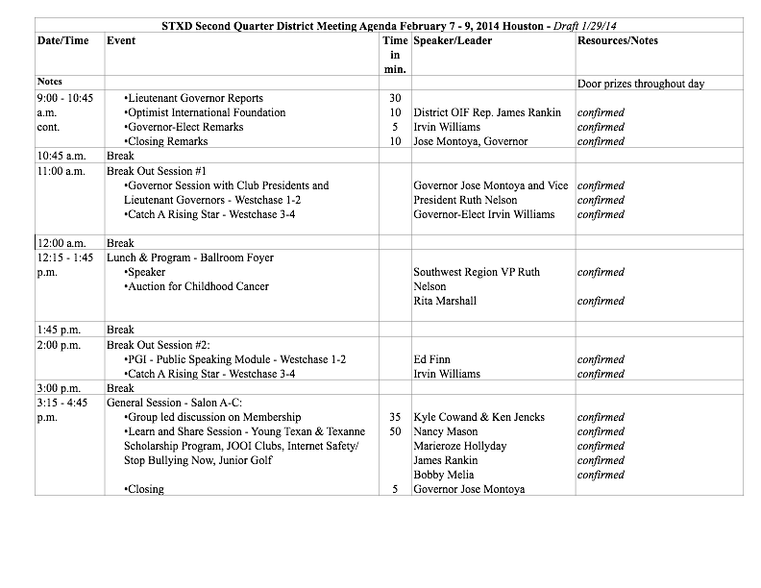
FOR EXAMPLE
Notes:
An example of a meeting/training planning grid/schedule:
Use it with your team for planning purposes
When confirmed, send to presenters and all involved

Slide 11
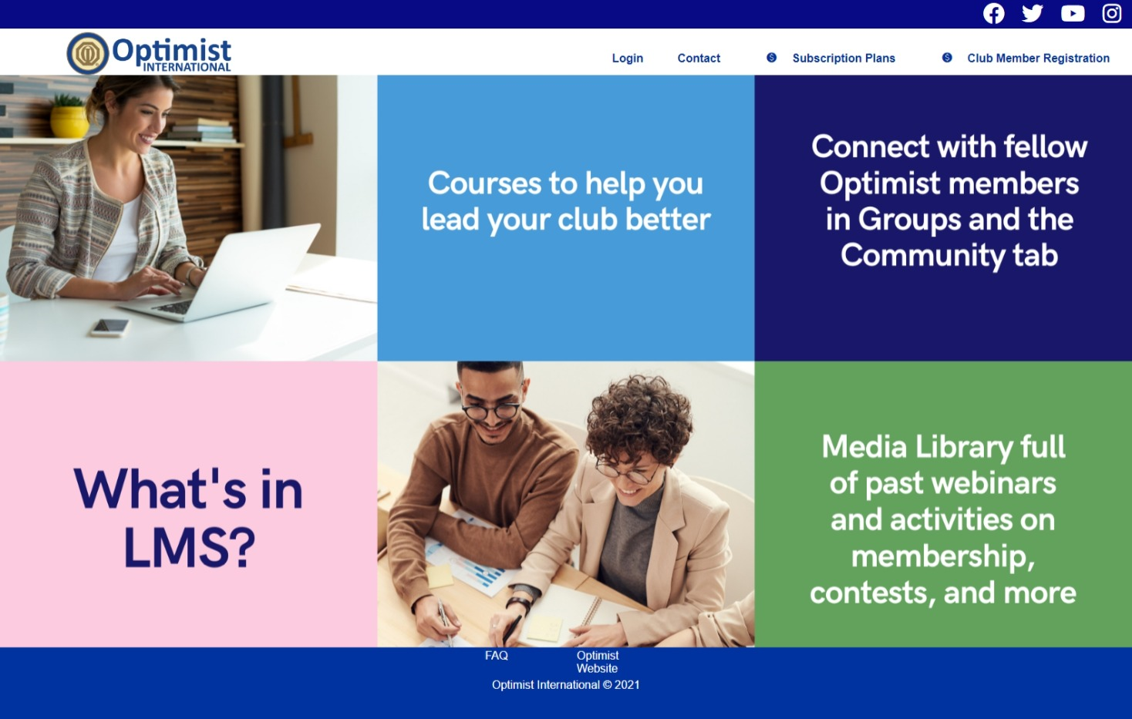
Optimist Learning Management System
Notes:
As you plan, be sure to keep the Optimist International LMS at the forefront.
Ask: How many of you have logged into the Optimist LMS? Have any of you worked through some of the modules?
The LMS will be one of your most important tools for ensuring that your leaders have been trained.
Ask: How will the LMS affect the training that you plan and recommend? (Don’t forget the ICD-135 requirements related to LMS.)

Slide 12
Virtual Training
What opportunities will you have to implement or continue virtual training in your District?
Notes:
In addition to onsite meetings, you have the opportunity to make a difference with virtual training opportunities.
Ask: What opportunities will you have to implement or continue virtual training in your District? What has worked so far? What platforms are you using? Just Zoom? What can you do better? What ideas do you have to take this training to the next level? Virtual learning can be one of your most powerful and far-reaching opportunities to ensure success in your Districts.

Slide 13
Facility Planning
Work with the Convention Chair to meet training requirements.
Ask presenters what they need, especially technology, audiovisual, and supplies.
Notes:
We’ve talked about:
Your role, as District Leadership Development Chair, and the importance of working with your Governor and Conference/Convention Chair
The importance of delivering excellent and relevant training
Planning, with details, for each event
Now let’s talk about two critical components of effective meetings and training: Facility Planning and Marketing Your Event.
During the planning stage of your Governor’s year ensure you are working with your Conference/Convention Chair
Ensure you have asked all your presenters (including your Governor) what they will need from a facility perspective to get their jobs done.
Ask: What are some things you might have on a checklist to ask them? List responses on a flipchart, if time allows Examples:
Podium
Projector
Screen
Electricity
What about a laptop? Will presenters provide their own?
WIFI
Flip Chart & Pens
Room Set Up style
Time allotted vs. time needed

Slide 14
Facility Planning
What can go wrong?
Be prepared to become a problem solver!
Notes:
What can go wrong? Ask group for examples, such as:
Room not set up correctly or inadequate facilities (set up theater style, instead of rounds; not enough breakout rooms)
Not enough projectors or screens for all presentations
Unavailability of a laptop when needed
No WIFI capability, and you know one of your presenters wants to show a video or go online
One of your presenters cancels at the last minute or doesn’t show up
You didn’t know your Governor/presenter had a specific technology requirement
Always think ahead. Why would you want to be prepared to problem solve?
Helps reduce stress
Builds your confidence and those of your committee
Enables things to go well (effortless)

Slide 15
Marketing Your Event
Planning, Planning, Planning!
Promotion, Promotion, Promotion!
Communication and Marketing!
Generate Excitement!
.
Relevance
Tools
Resources
Methods
Notes:
Plan, Plan, Plan!
Promote, Promote, Promote! Communication is the key. It’s one thing to have great promotional materials, but another to actually communicate them out to members. In your communications and marketing, the following aspects must be answered for the member interest and buy-in:
Relevance. This should be heavily promoted and at the forefront. What’s in it for me? Are you meeting needs when they need to be met? Let attendees know you are meeting needs. The most important!
Examples:
Officer Training for new year
District Conference events/sessions
Ongoing Training
Tools. Promote what’s different “from last time.” What tools for success are you going to give them?
Mix it up… different agendas and interesting promotions
Different, interesting speakers
Facilitating ‘how’ to do this….
Contests and other promotions - Attendance, prizes, fun
Resources. Promote the resources you will be providing.
Website
LMS
Methods. How will you disseminate this information? The goal is to use 3 methods to send out the information. Important -- People remember 20% of what they hear, 30% of what they see, 50% of what they see and hear, and 90% of what they see, hear and do. Methods include:
Emails
Electronically (websites and mass messaging)
Letters
Person to person
Word of Mouth
Ask: What are some ideas for marketing a training/meeting that you think would be effective, dynamic, and exciting? What has worked in your Districts?

Slide 16
Marketing Your Event
Methods
Social Media
Videos
Mass Messaging
Websites
Which method will generate the most excitement?
Notes:
Communication is the key. Here are some examples of the types of methods you could use to promote and communicate your training events:
Social Media: Facebook, Twitter, Instagram, TikTok
Video: YouTube; promotional clips sent through email or Constant Contact
Mass Messaging Tool: Constant Contact—How much is too much?
Websites: District Websites; Club Websites
Ask group: Are there others that you are using? What’s working in your Districts?
Let’s look at some outstanding examples, from the GATEway District/SE Region, used to promote their training and meetings.

Slide 17
Marketing Your Event

Slide 18
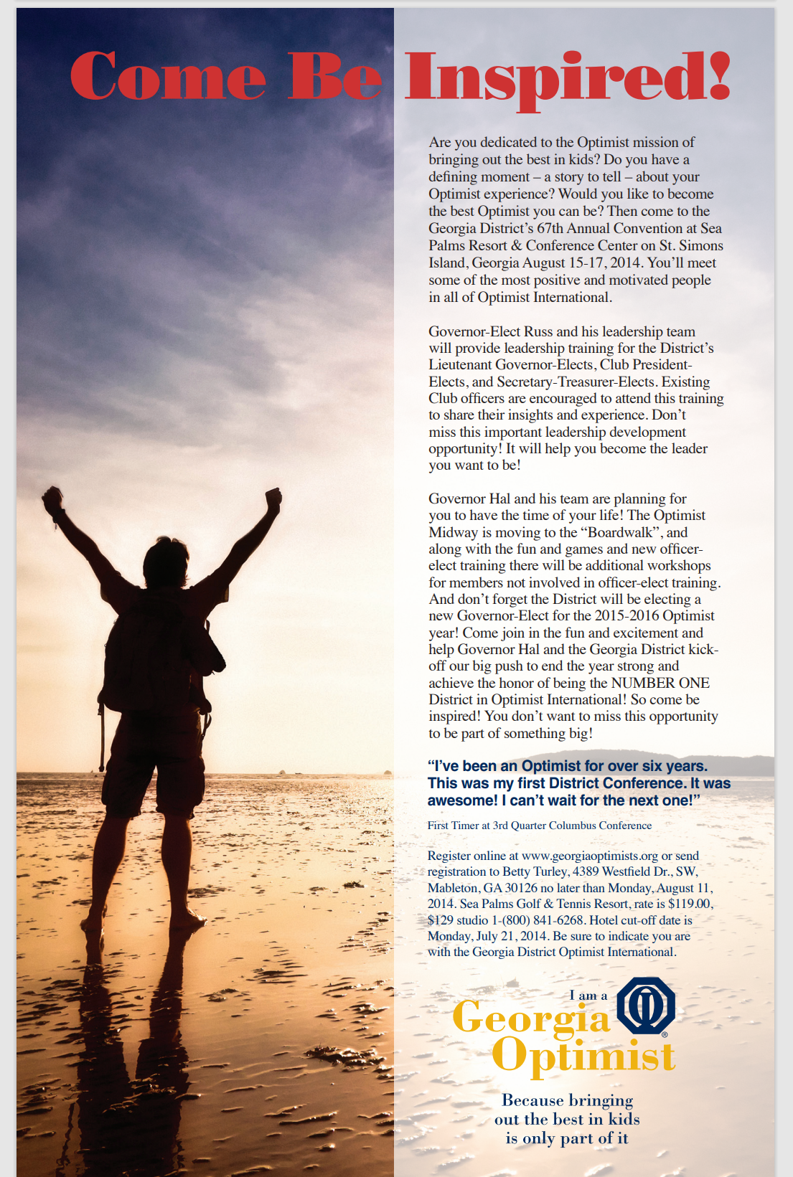
Marketing Your Event

Slide 19
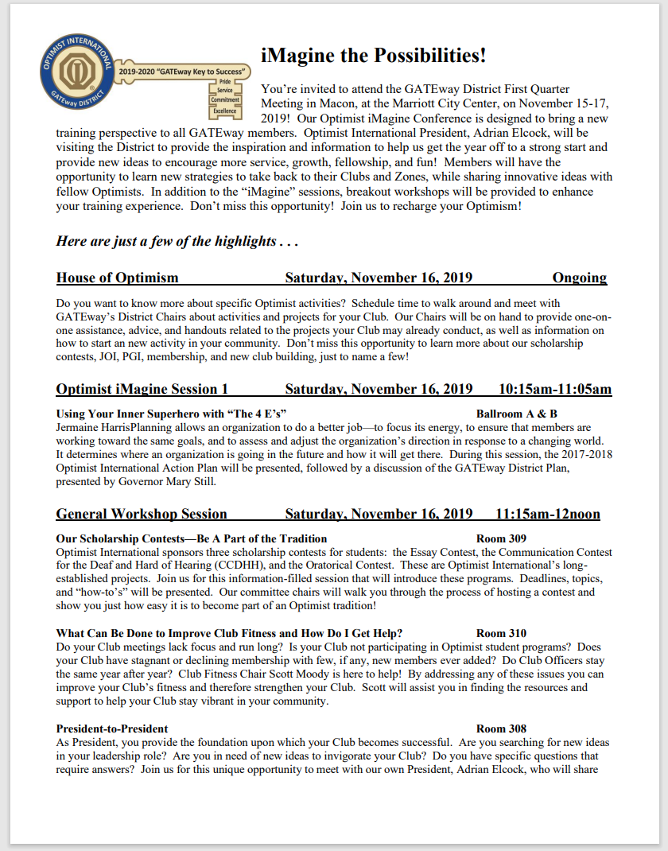
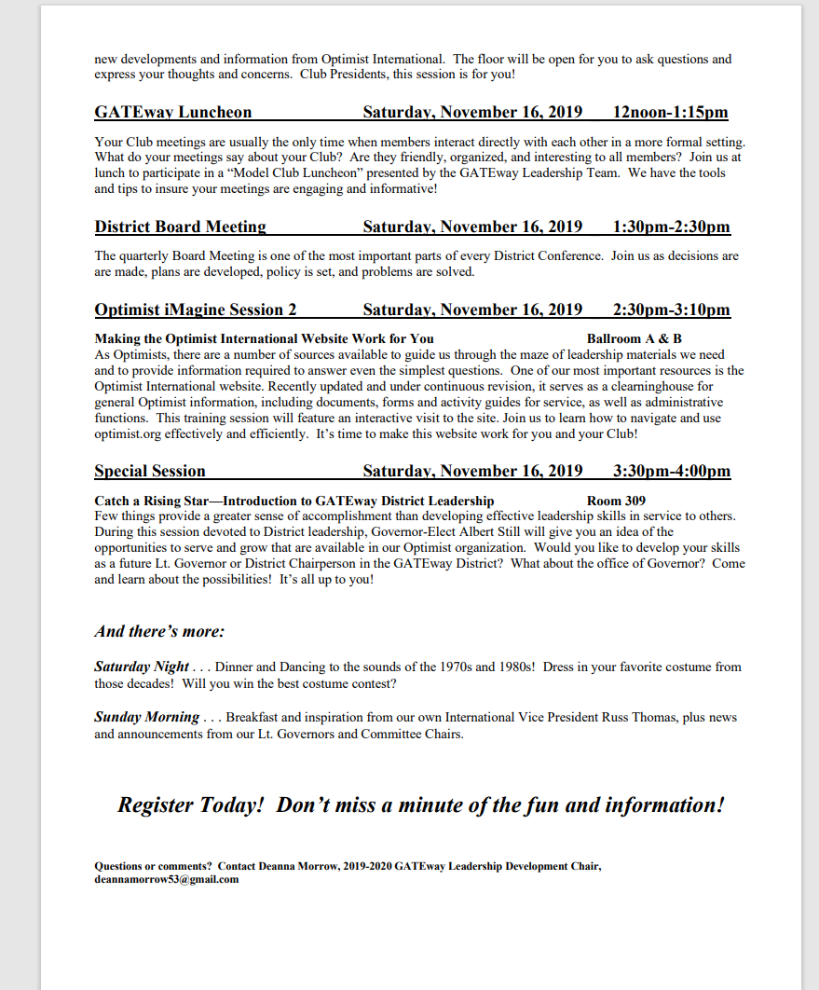
Marketing Your Event

Slide 20
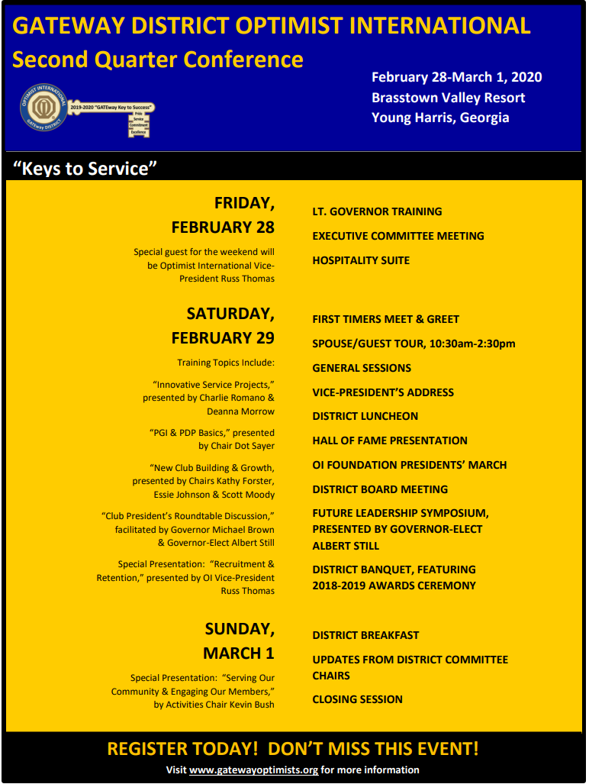
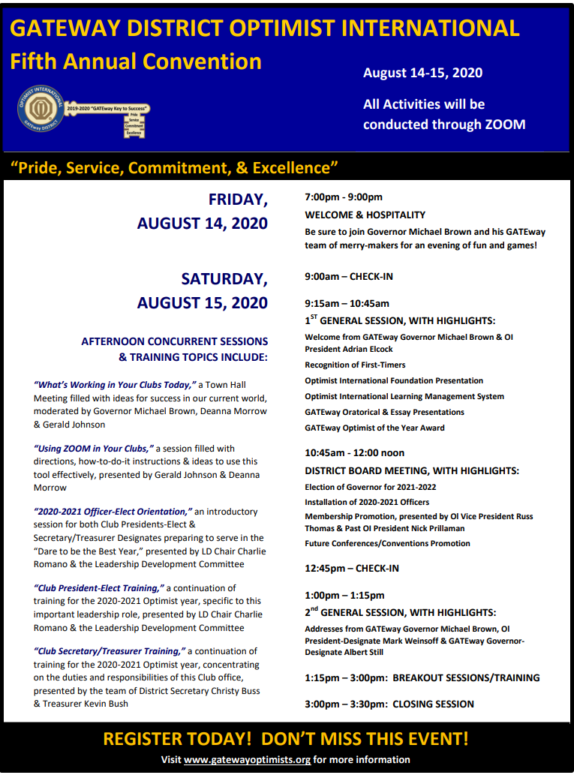
Marketing Your Event

Slide 21
Marketing Your Event

Slide 22
Group Exercise
Adding Value to Your Meetings:
Brainstorm – How can you, as Leadership Development Chair, add value to the meetings in your District?
Agree on top three
Share top three with the group
Notes:
Let’s take a moment to reflect together. We have spoken so much about adding value. But what does that mean for YOU? Specifically, how will YOU add value as your District’s LD Chair? Discuss at each table and share the top three from your table. Examples include:
Train officers
Tools and resources to Clubs
Website
Webinars
Conference calls/Virtual meetings
Motivate and inspire Optimists...
FOCUS - to achieve the Governor’s and District’s goals, don’t get side tracked!

Slide 23
Other Training Preparation
As Leadership Development Chair, what are other trainings/meetings you may have to prepare for your District?
Notes:
Ask participants to share ideas.
Other Training Preparation:
Leadership Retreats
Lieutenant Governor-Elect Training
Club President-Elect Training
Secretary/Treasurer-Elect Training
Committee Chairs Training
Catch a Rising Star
Skills Development Modules (PGI)
Zone Meetings
Club Meetings
Virtual Seminars/Meetings (Working with Governor and Chairs as a team)
As always focus on goals/outcomes for each event. Plan each event, while concentrating on each individual training opportunity. As always, communicate for success. The best plans and best training will not reach attendees if they don’t know about the opportunities that exist.

Slide 24
Be Your Target Audience
What do members want?
What did you want to know when you were:
Club Member (new or first conference)
Club Chair
Secretary - Treasurer
Lieutenant Governor
Club President
Notes:
Be your target audience when you begin to plan.
How often have you heard that members didn’t get what they wanted at a meeting?
Assume you are an officer who has just been elected–-a Club President, a Secretary/Treasurer, a Lieutenant Governor, or a member attending an event for the first time.
What do you want to know?
What do you want to know about member recruitment?
Other questions?
In serving these various audiences: What do they want/need to know? And meet that need.

Slide 25
Quality Training for Officers & Members
What will they need for a successful year?
?
Information
Tools
Resources
Motivation
Notes:
Group Facilitation / Discussion—Drilling down to the planning process. What will our officers/members need for a successful year?
Use an example - District Leader Training – On chart – Draw circle in center with circles off center
In center - Quality training for Presidents
Information they will need for success
Tools & resources to be able to find answers they need throughout the year
How you will motivate them to achieve their goals
Brainstorm what might be included to achieve the outcome, and share with whole group and write on chart

Slide 26
District Training Events
What will you need for a successful year?
The most important points:
Purposeful meetings
Plan and present training, based on established goals and themes for the year
Use available resources on Optimist website and LMS
Communication and marketing
Generate excitement!
Notes:
Let’s look at a quarter-by-quarter breakdown to meet the needs in each District. Here are a few ideas to ensure you, as the Leadership Development Chair, are successful in your endeavors.
1st Quarter: Fast start, with all programming geared towards goal setting and getting the tools to people to get started immediately to ensure success. Use the Governor’s theme to inspire members to action.
2nd Quarter: Taking a fresh look at the Club, with all programming geared towards improving Clubs. Workshops on member retention; publicity; energizing meetings; leadership development; etc.
3rd Quarter: Expanding service, with all programming geared towards growth in membership, fundraising, and activities. NOW/WOW programs; best fundraising ideas; new programs, etc.
4th Quarter: Finish Strong, with all programming geared towards helping Clubs achieve their goals. New Club Building; available resources to help; incentives to finish strong; etc.
It seems one of the problems in our organization is we go through the motions at quarterly meetings when we should be using this time to energize our members. Too often their time is wasted with the same old message. That is why we continually hear people say things like, “You only talk about membership.” They say this because we are not delivering the message properly. What can we do?

Slide 27
Developing Future Leaders
Identifying future leaders
Creating a desire to take on leadership roles
Leadership development tools
Nurturing future leaders
Encouraging members to take leadership roles
Notes:
One of your roles as Leadership Development chair is “to cultivate and encourage further Optimist leaders.”
Ask: Why should we care about finding future leaders?
Repeat leaders tend to burn out
New leaders bring new ideas
We need a feeder base of leaders at all levels: Club, District and International.
Ask: How do you identify future leaders? Capture on flip chart, if time allows:
Ask Club Presidents, current and past
Look at the people who are successfully leading projects/fundraisers in our Clubs
Ask Lt. Governors
Ask members and keep asking. People’s willingness to take on a leadership role can change over time (children grow up and leave home; retirement, etc.)
Have succession plans for all key leadership roles in our Clubs and Districts
Ask: What’s in it for them to take on a leadership role in their Clubs and/or Districts and Optimist International?

Slide 28
Developing Future Leaders
What are some of the skills you would look for in a leader?
Delegator
?
Communication
Motivation
Optimistic
Trustworthy
?
Flexibility
Creativity
Commitment
Responsibility
Feedback
Notes:
Ask: What are some of the skills you would look for in a Leader? Capture on flip chart, if time allows. Then review these Top 10 Leadership Skills.

Slide 29
Developing Future Leaders
PGI
Ten Levels of Achievement
Elements are consistent throughout the levels:
Attendance
Activities
Growth
Knowledge of the Organization
Self Development
Communication
Personal Growth Modules
Notes:
PGI = Honor Club for Members:
Built upon attributes of healthy Club/member
Recognizes and appreciates Club members for personal and professional accomplishments
Gives members an opportunity to participate in long-term Club involvement while learning more about Optimism
Gives each member the personal responsibility for his/her involvement in the Club’s activities
Offers personal growth/professional development opportunities to each member
Provides members with Club meeting, membership recruitment, and retention ideas
The PGI Program offers every Optimist Club member:
The opportunity to grow personally at their own speed
Learn more about Optimism
Advance through ten levels of involvement, personal growth, and achievement
Elements are consistent throughout the levels of PGI:
Attendance - Encourages members to attend meetings and Club events
Activities - Encourages involvement in service projects, serving on Club and District committees, to take leadership positions on committees, and to develop new service projects
Growth - Encourages members to take initiative and responsibility for growth of their Club
Knowledge of the Organization - members become informed on the history and purposes of our organization
Self Development - Members are encouraged to expand their presentation skills though a series of brief presentations on Optimist topics
Communication - Members expand their leadership skills through presentations to their Club and District members about our organization
Additionally, personal growth for individual members through modules (Skills Development Modules on Public Speaking, Effective Time Management, Creative Problem Solving, Choosing Optimism as a Philosophy of Life, Orientation to Optimism for New Members, Parliamentary Procedures, Team Building, Leadership Styles & Profiles and Mentoring)

Slide 30
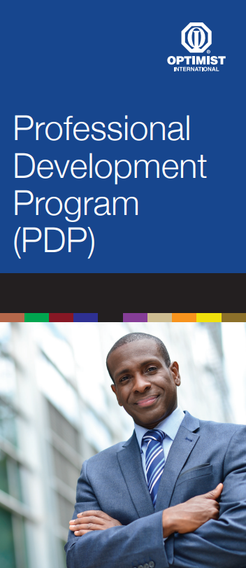
Developing Future Leaders
PDP
Program to develop personal professional growth
Grows and recognizes individual leadership skills
Encourages healthy member participation and Club growth
Emphasis:
Project Management
Marketing
Continuous Improvement
Organizational Knowledge and Culture
Communication Skills
Notes:
PDP
The PDP program is meant to provide members with a way to develop professionally. Members will have the opportunity to build skills that will help them professionally and enhance their Club, District, and Optimist International.
Our organization wants to bring in younger professionals. The PDP is a tool to help do that.
The PDP Program offers every Optimist Club Member:
The opportunity to work at their own speed
Learn more about Optimism, while enhancing professional skills
Advance through ten levels of involvement and achievement, with three advanced levels
Elements are consistent throughout the levels of PDP:
Project Management
Marketing
Continuous Improvement
Knowledge of the Organization - Members become informed on the history and purposes of their organization
Communication - Members expand their leadership skill thorough presentations about our organization
Review materials, if time permits.
How will you use PDP in your District?

Slide 31
Developing Future Leaders
“Catch a Rising Star”
Future Leaders” workshop designed to help identify, encourage and develop the future leaders of our organization
Intended to be an informative session explaining opportunities at the Club, District, and International level
Explains how being a leader can help in achieving personal goals
Notes:
Ask: How many people have been involved in a “Catch A Rising Star” Workshop? How successful is this workshop in your District?

Slide 32
Notes:
You are the key to your Governor’s and District’s success! Let’s get started planning for the upcoming year. Explain the planning handout. Be sure to allow for a recap to allow participants to talk about their plans.

Slide 33
Notes:
Thank you for spending your time this morning to learn more about your job! Remember the key—training of value!

